Slide 1
Managing Information Technology Resources ITWS 4310
Google Case
November 8, 2018

Slide 2
Managing IT Resources Class Outline: Thursday, Nov 8, 2018
Final Presentation Schedule
MITR Term Project
Schedule Meetings with Client and Invite Faculty to Meetings
Work on Design and Development
Draft of Entire Term Project Final Report on Nov 19 by 9 PM
Initial Sections Feedback
Current Events
Chapter 18: Google Case

Slide 3
Randomly Assigned Final Presentation Schedule
Thursday Dec 6
Team 5
Team 2
Team 4
Monday Dec 10
Team 3
Team 1
Team 6
Invite your Clients to attend your class presentation and any or all of the other presentations on the two days.
In Addition, offer to present in a longer format (~ 1 hour) at the Client’s Location or on a Video Link to the Client’s Location.
If your Client cannot attend the day scheduled, but could on the other day, let us know and we will try to accommodate.
Presentations will be 15 minutes long with 5 minutes for Q&A. Time will be monitored and you will be given visual warnings at 3, 2, 1 minutes respectively.

Slide 4
Managing IT Resources: ITWS 4310 Term Project Report Outline
Section 1: Executive Summary
Section 2: Introduction
Section 3: Client Organization and Description
Section 4: Project Team
Section 5: Problem Statement
Section 6: IS/IT Solution
Section 7: Methodology
Section 8: IS/IT Requirements
Section 9: IS/IT Design
Section 10: Cost-Benefit Analysis with (Risk Mgmt)
Section 11: Project Plan/Schedule/Resources
Section 12: Post-Turnover Plan
Section 13: Results and Client Feedback
Section 14: Conclusions
All Sections of Final Report in Draft due by Nov 19 (Mon before Thanksgiving) at 9 PM

Slide 5
Managing IT Resources: ITWS 4310 Term Project Report Outline
Section 1: Executive Summary
Should be able to “stand on its own”
Provides an “executive” overview of the entire project
What are the important points that an executive would need to know?
The best summaries effectively balance details with a concise writing style

Slide 6
Managing IT Resources: ITWS 4310 Term Project Report Outline
Section 2: Introduction
Keep it short – 2-3 sentences
Only 2 objectives: provide a little context for the project and pique interest to read on
Section 3: Client Organization and Description
Give some idea of the size of the organization: number of employees, number of locations, etc.
Include Client Contact name and contact information
Section 6: IS/IT Solution
If solution has changed throughout semester, make reference to the original solution concept and then describe current/latest solution concept
Section 7: Methodology
Brief description of how each major aspect of project was done e.g. a cost benefit analysis focused on NPV and IRR was used to assess financial viability of the project. Don’t’ be repetitive with subject section
Cover project/client selection, requirements, development methodology, financial viability, project management, implementation methodology, and client feedback method

Slide 7
Managing IT Resources: ITWS 4310 Term Project Report Outline
Section 8: IS/IT Requirements
Categorize both Functional and Non-Functional Requirements
Section 9: IS/IT Design and Development
Use-Case Summary (part of narrative) and Use-Case Diagram
Work Flow Diagram (logic that connect back-end with front-end)
Back-end Design including Data Work Flow and Database Design
Front-end Design including Mock-ups, Wireframes, Screen Shots
Working System including link to working system or prototype
Access to Code in Code Repository
Test Plan(s) and Test Results
Narrative of All Design and Development
Section 10: Cost Benefit Analysis with Risk Management
Combine the Excel Sheets for CBA and Risk Management into one Excel Workbook
Combine the CBA and Risk Management into one Narrative

Slide 8
Managing IT Resources: ITWS 4310 Term Project Report Outline
Section 11: Project Management/Resource/Schedule
Specify reference to separate Gantter project plan
Include screenshot showing entire project in report
Summary of major project phases including the duration, work effort, costs for each phase. Can be organized into a summary table
Section 12: Post-Turnover Plan
Installation
Training
Documentation
Future support and maintenance plan

Slide 9
Managing IT Resources: ITWS 4310 Term Project Report Outline
Section 13: Results and Client Feedback
Specify what functionality was delivered when
Results showing that the System meets the “Requirements” or not
Client Feedback
Section 14: Conclusions
What were the “lessons learned” by the team
What worked well
What didn’t work well
What would you do differently “next time”
Cover team dynamics, client dynamics, and technology

Slide 10
Managing IT Resources: ITWS 4310 Term Project Report – Initial Sections Feedback
General Feedback
Use of 3rd person
Spelling, grammar, formatting
Writing quality & overall delivery
Content
Document Flow & Cohesiveness
Understand purpose
Understand audience
Look at past examples

Slide 11
Technology Current Events: “People are ripping Bezos apart, calling Amazon's reported HQ2 decision 'a shameful charade' and 'grotesque’”, AOL, November 6, 2018. https://www.aol.com/article/finance/2018/11/06/amazon-hq2-reactions/23581692/
After months of deliberation and swirling rumors as to which U.S. city Amazon would choose as the location for its new HQ2, it seems as though we have an answer — and that answer is apparently two different HQ2s in two different cities?
Per a New York Times report on November 5, it looks like the e-commerce behemoth has plans to split its new headquarters between Long Island City (Queens, New York) and Crystal City (Arlington, Virginia).
Suffice it to say, people are less than thrilled, especially as the decision would employ 50,000 new workers split between the two cities instead of centralizing all new workers in one location.
In January, Amazon publicly announced a list of the 20 U.S. cities it would be considering for the new headquarters, with many of those locations set to benefit from new infrastructure and the influx of employment opportunity.
To many people, the entire ‘Battle for HQ2’ seems to have been nothing more than a way to generate buzz for the company, peer into each city’s potential to formulate a bidding plan, pool resources and supply incentives for Bezos and his tech army.
‘So Amazon lied throughout the entire H2 search process,’ one user Tweeted. Others called the leaked info about two HQ2 offices ‘an enormous PR stunt’, a 'shameful charade’, ‘grotesque’ and perhaps the harshest of all, ‘lame.’

Slide 12
Technology Current Events: “Facebook opens small business pop-ups in nine Macy's stores”, Engadget, November 5, 2018. https://www.engadget.com/2018/11/05/facebook-macys-small-business-pop-up/
Facebook is bringing around 100 digital-native brands and small businesses that have found success on the social network and Instagram to physical retail locations. It's opening pop-ups at nine Macy's stores as the holiday shopping season gets underway.
The Facebook Small Business Pop-ups opened Monday in New York City, Pittsburgh, Atlanta, Fort Lauderdale, San Antonio, Las Vegas, Los Angeles, San Francisco and Seattle, and they will be available until early February. The brands featured at the pop-ups include Love Your Melon, an apparel brand that's helping the fight against pediatric cancer; Charleston Gourmet Burger Company, which sells a burger marinade; and Two Blind Brothers, a clothing company that donates all of its profits to research for a blindness cure.
The Macy's partnership could be a case of Facebook testing the water for broader retail efforts. The company is making a push into the hardware market, including with its Oculus VR headsets and Portal video chat displays. If the Macy's pop-ups go well, it's not difficult to imagine a scenario in which Facebook opens stores for its own products. The Macy's collaboration follows Amazon growing its own physical retail footprint, such as with its Amazon Go shops, Whole Foods business and its new 4-star stores, which stocks new and trending items on Amazon as well as products that users have rated four stars or more.

Slide 13
Technology Current Events: “Nearly 17,000 Google employees walked off the job yesterday. We spoke to 3 of them.”, Vox, November 2, 2018. https://www.vox.com/the-goods/2018/11/2/18056390/google-walkout-employee-interviews
Nearly 17,000 Google employees walked off the job yesterday as part of a massive, worldwide protest against the company’s mishandling of sexual harassment cases.
The walkout, which was organized by seven Google employees, was a response to a New York Times report on the multimillion-dollar payouts offered to high-level employees who had been accused of sexual misconduct. Some protesters carried signs that read, “Happy to quit for $90m,” a reference to the exit package Google gave Andy Rubin, the creator of Android, who was forced to leave the company in 2014 after an employee accused him of forcing her to perform oral sex on him. “What do I do at Google? I work hard every day so the company can afford $90,000,000 payouts to execs who sexually harass my coworkers,” read another.
It was also an opportunity for Google employees — who have repeatedly clashed with senior management on a number of topics, from censorship in China to the company’s role in government projects — to put forth a vision for a better, more equitable company.
“A company is nothing without its workers,” the organizers wrote in a piece for the Cut. “From the moment we start at Google, we’re told that we aren’t just employees; we’re owners. Every person who walked out today is an owner, and the owners say: Time’s up.”
“I’VE BEEN SEEING MORE AND MORE OF A RIFT BETWEEN THE TOP-LEVEL EXECS AND THE REST OF THE COMPANY”
“I HAVE WORKED WITH AN OVERWHELMING MAJORITY OF MEN. THAT, IN AND OF ITSELF, LEADS ME TO THINK THAT THE FACT THAT I AM MALE-IDENTIFIED AND MALE-PRESENTING MAKES THINGS EASIER FOR ME.”

Slide 14
“Google Case”
What is the history of Alphabet/Google?

Slide 15
“Google Case”
What is the history of Alphabet/Google?
Founded 1998
AdWords 2000
Patented PageRank 2001
AdSense 2003
IPO 2004
Gmail 2004
Google Maps 2005
YouTube 2006
Android 2008
Chrome 2008
Google Fiber 2010
Google Drive 2012
Alphabet 2015

Slide 16
“Google Case”
What is the history of Alphabet/Google?
Notes:
https://www.officetimeline.com/blog/google-history-timeline

Slide 17
Google History
The firm’s founding duo, Sergey Bin and Larry Page, are billionaires
Within six years of the IPO, Google had become one of the twenty most profitable firms in the United States and was the youngest firm on the list, by a wide margin.
Market capitalization (market cap): Value of a firm calculated by multiplying its share price by the number of shares.
Google’s market capitalization was over $759 billion as of November1 2018

Slide 18
“Google Case”
In what businesses does Alphabet/Google compete?

Slide 19
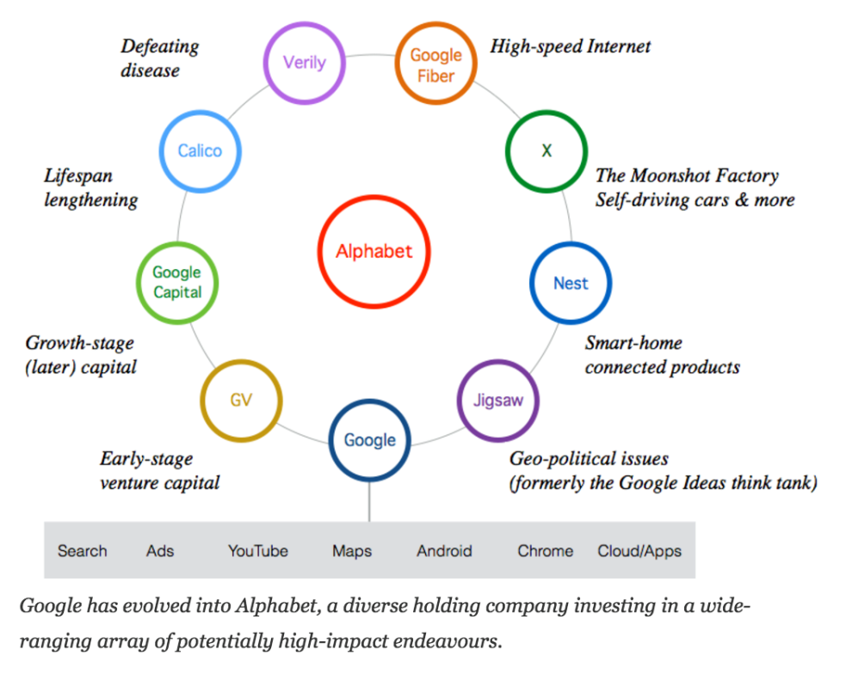
The Businesses of Alphabet

Slide 20

Google – The Business Unit
Ad Network
VOD
Search
Music
Mobile
Payments
Cloud
Services
Mobile OS
Browser
AppStore
PC OS
Phone
Productivity
Apps
Email

Slide 21
“Google Case”
Who are Alphabet/Google’s competitors?

Slide 22
The Competitors of Alphabet
Tencent
Amazon
Apple
Baidu
Yahoo
Microsoft
Uber
IBM
Twitter
eBay
Spotify
Hulu
Yelp
Tesla
Facebook
Netflix

Slide 23




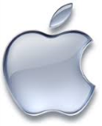


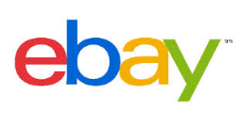

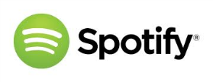




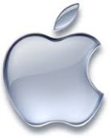


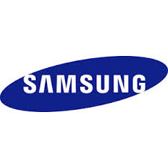


The Competitors of Google
Ad Network
VOD
Search
Music
Mobile
Payments
Cloud
Services
Mobile OS
Browser
AppStore
PC OS
Phone
Productivity
Apps
Email

Slide 24
“Google Case”
What are major Alphabet/Google “Competitive Advantages”?

Slide 25
Google’s Competitive Advantages
Major scale advantages in search and network effects in advertising.
Multiple ad networks make it easier to shift business between firms.
Facebook’s ad network may pose an especially worrisome threat
Switching costs for search users are incredibly low
Innovation
Global Brand
AI/Machine Learning

Slide 26

Ad Networks and Competitive Advantage
Ability to reach more potential customers attracts more advertisers.
Content providers look for ad networks with the most advertisers.
More participants bring in more revenue and help the firm benefit from scale economies.
Better return on investment from its ad technology and infrastructure.

Slide 27
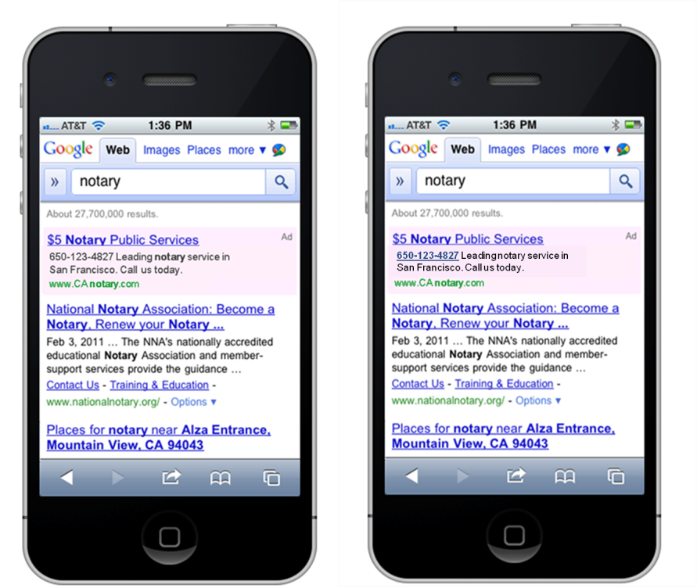
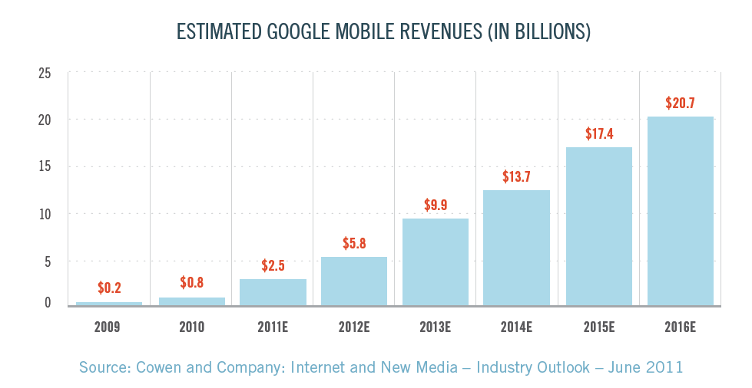
Google’s problem with mobile apps
Mobile users spend an estimated 86 percent of their time in apps and only 14 percent on the Web.
Individual, specialized apps draw users away from Google.
App owners are becoming even more useful advertisers with the rise of deep linking (a link that takes a user to a specific webpage, or launches an app and brings up a unique location rather than just launching the app).

Slide 28
“Google Case”
As the “Search” industry matures, what are major “Risks” to Alphabet/Google’s current high stock price?

Slide 29
“Google Case”
As the “Search” industry matures, what are major “Risks” to Alphabet/Google’s current high stock price?
Can’t maintain growth
Too dependent on Google (business unit)
Too dependent on partners
Mobile
Too many “misses”, not enough “hits”
Bad acquisitions?
Cash flow?

Slide 30
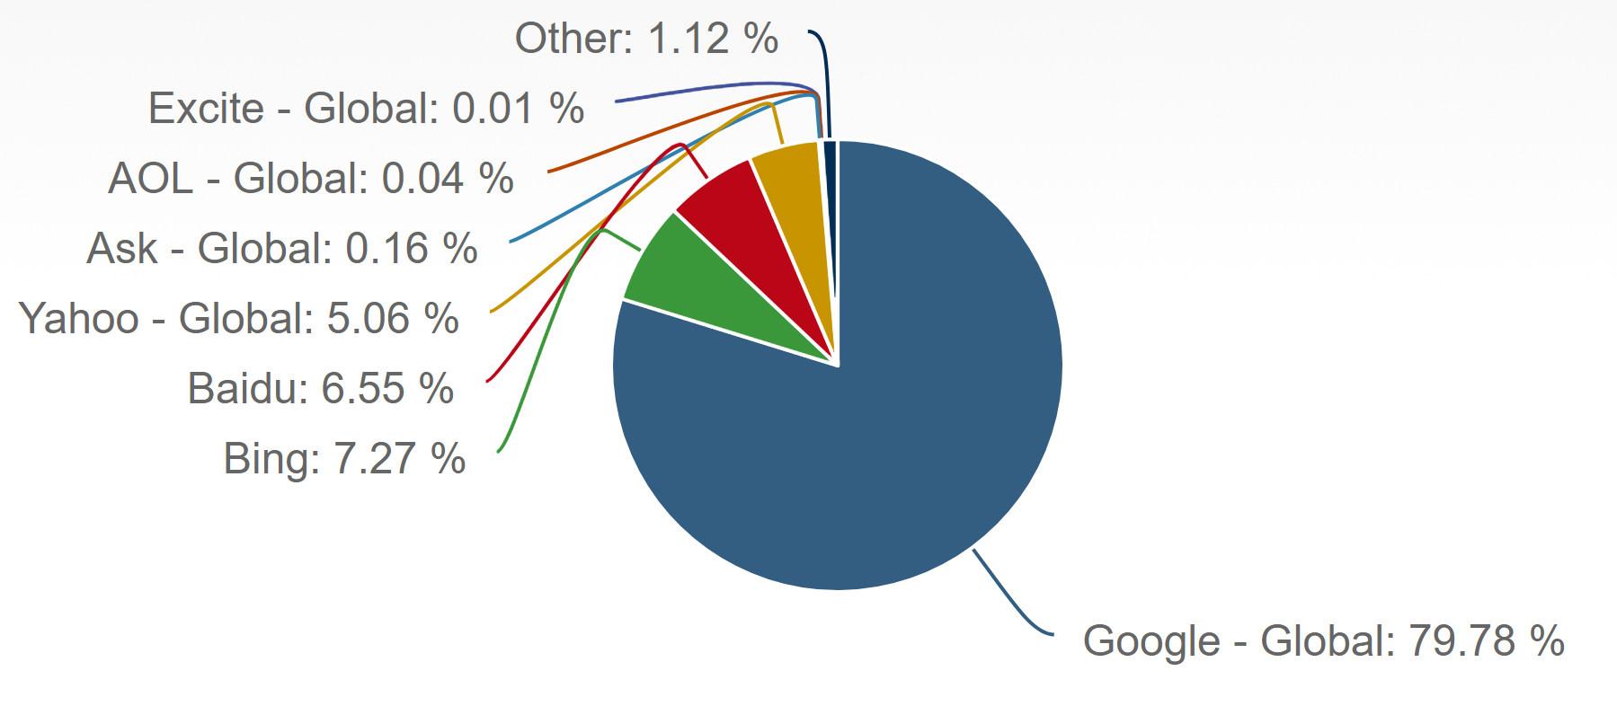
Global Search Market Share 2017 https://www.netmarketshare.com/search-engine-market-share.aspx?qprid=4&qpcustomd=0&qptimeframe=Y

Slide 31
What Google faces
Possible slower growth putting pressure on stock price.
Need to pursue large, risky new markets.
Google has been investigated for anti-trust violations.
Investing heavily in methods to promote wider Internet access.
Google Glass has struggled to achieve consumer acceptance.
Android Pay is looking to allow phones to replace the “stuff” inside your wallet.
Google’s success in social media has been mixed with its two biggest success (YouTube and Blogger) being acquired from other firms.

Slide 32
“Google Case”
How is Alphabet/Google using “Data and Analytics”, “Machine Learning” and “Artificial Intelligence” to create and maintain “Competitive Advantage”?

Slide 33
“Google Case”
How is Alphabet/Google using “Data and Analytics”, “Machine Learning” and “Artificial Intelligence” to create and maintain “Competitive Advantage”?
Platform – Tensor Flow
Google Analytics
Google Assistance
Waymo
Waze

Slide 34
“Google Case”
How are competitors using “Data and Analytics”, “Machine Learning” and “Artificial Intelligence” to gain “Competitive Advantage” over Alphabet/Google?

Slide 35
“Google Case”
How are competitors using “Data and Analytics”, “Machine Learning” and “Artificial Intelligence” to gain “Competitive Advantage” over Alphabet/Google?
Self-driving cars
Facebook – more data profiling for each user
Specific & precise
“One-stop shop”
Uber – everything
Amazon – search?
eBay – image search?

Slide 36
“Google Case”
How do the Market Capitalization (recent value), Revenue (most recent year), Revenue Growth Rates (5 yr. growth rate), Gross Profit Margins (5 yr. avg.), Net Profit Margins (5 yr. avg.) and Stock Price Comparison for the Last 5 Years compare for Alphabet/Google, Facebook, Microsoft, Baidu, and Amazon? See Financial Results at www.reuters.com/finance and previous cases in this course.

Slide 37
Alphabet, Amazon, Baidu, Facebook, Microsoft Financials
Financial Metric | Alphabet | Amazon | Baidu | Facebook | Microsoft
Market Capitalization (Now) | $760 B | $853 B | $67 B | $432 B | $859 B
Revenue (2017) | $110 B | $177 B | $84 B | $40 B | $110 B
Revenue Growth Rate (5 yr avg) | 19% | 23% | 37% | 49% | 4%
Gross Profit Margin (5 yr avg) | 62% | 31% | 59% | 83% | 66%
Net Profit Margin (5 yr avg) | 22% | 0.7% | 32% | 26% | 22%
Stock Price Change (last 5 years) | ~200% | ~400% | ~150% | ~800% | ~210%
Stock Price Change (last 5 years) | ~112% | ~373% | ~19% | ~206% | ~196%

Slide 38
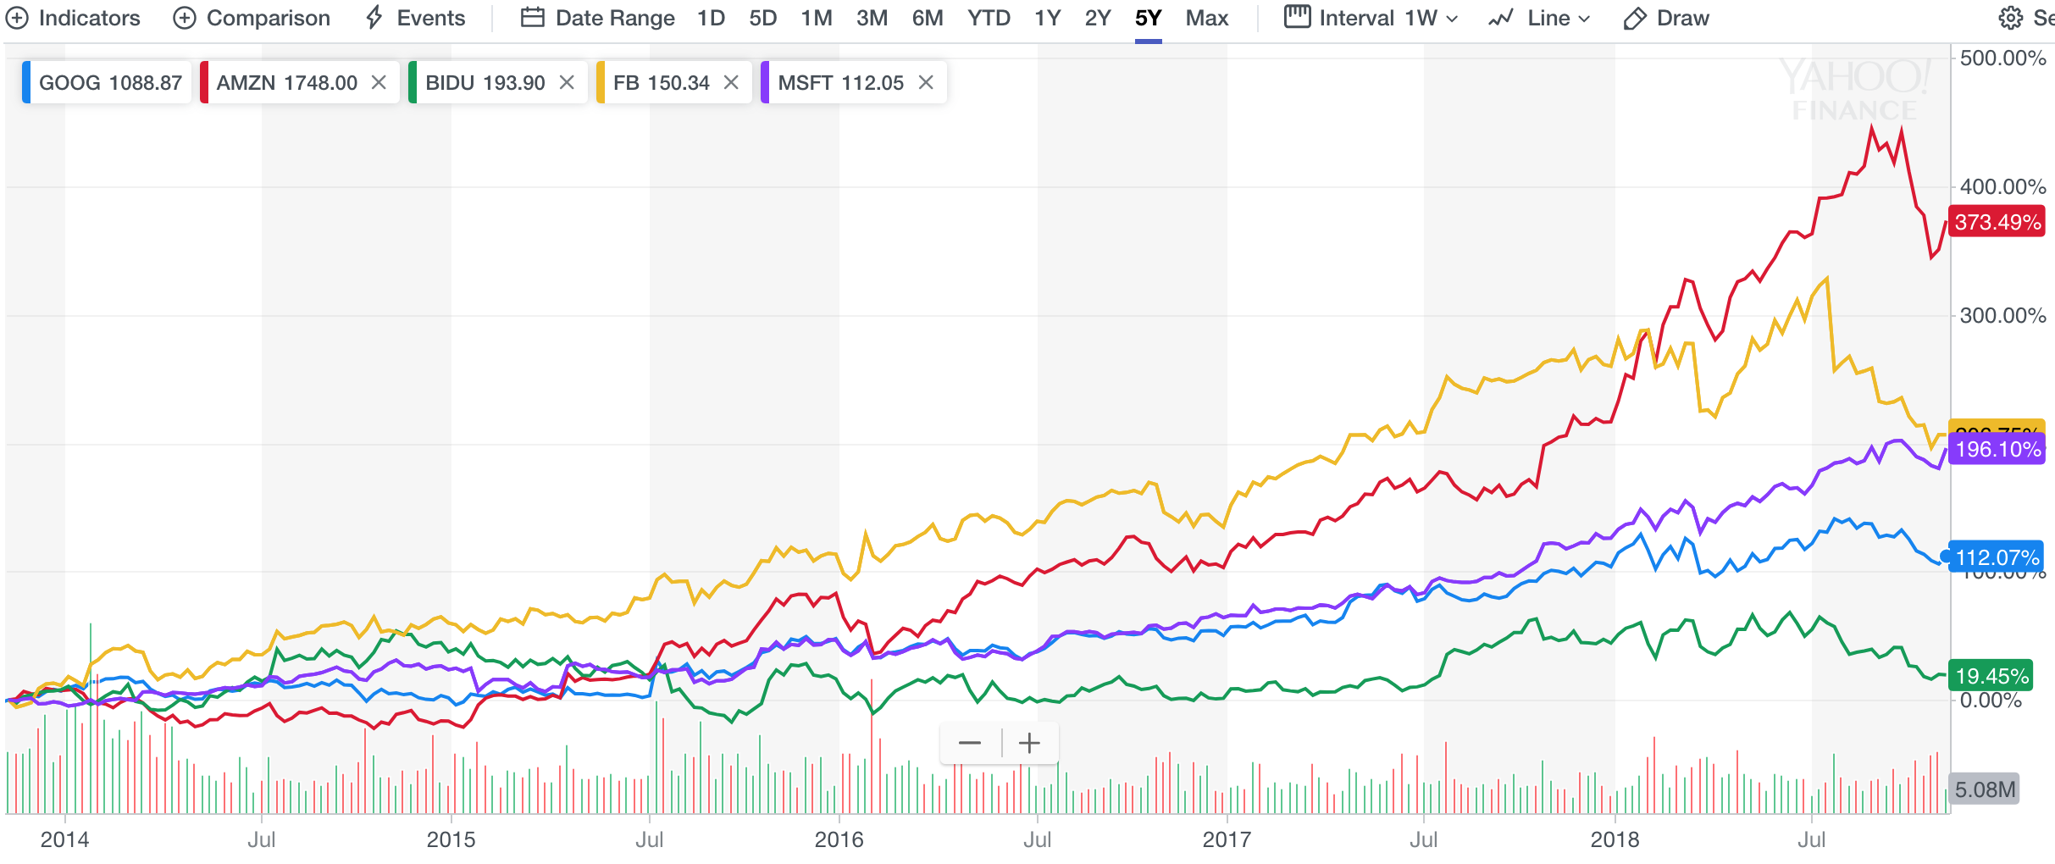
Alphabet, Amazon, Baidu, Facebook, Microsoft Financials Stock Price Change Last 5 Years

Slide 39
“Google Case”
Considering “Machine Learning”, discuss how Alphabet/Google could succumb to this “Technology Risk”. Name the “Competitor” and the “Technology Domain” (search, driverless cars or others) that might weaken Alphabet/Google, the “Probability” that it would occur, and the “Impact” (change in Market Capitalization over 1 year) if it did occur. How would you recommend that Google/Alphabet “Mitigate” this “Risk”?

Slide 40
“Google Case”
Considering “Machine Learning”, discuss how Alphabet/Google could succumb to this “Technology Risk”. Name the “Competitor” and the “Technology Domain” (search, driverless cars or others) that might weaken Alphabet/Google, the “Probability” that it would occur, and the “Impact” (change in Market Capitalization over 1 year) if it did occur. How would you recommend that Google/Alphabet “Mitigate” this “Risk”?
Facebook?
Amazon?
Apple?

Slide 41
“Google Case”
Considering “International Market Competition”, discuss how Alphabet/Google could succumb to this “Market Risk”. Name the “Country” and “Competitor” that might weaken Alphabet/Google, the “Probability” that it would occur, and the “Impact” (change in Market Capitalization over 1 year) if it did occur. How would you recommend that Google/Alphabet “Mitigate” this “Risk”?

Slide 42
“Google Case”
Considering “International Market Competition”, discuss how Alphabet/Google could succumb to this “Market Risk”. Name the “Country” and “Competitor” that might weaken Alphabet/Google, the “Probability” that it would occur, and the “Impact” (change in Market Capitalization over 1 year) if it did occur. How would you recommend that Google/Alphabet “Mitigate” this “Risk”?
Baidu in China?
Yahoo in Europe?

Slide 43
“Google Case”
Considering one “Social Issue” (privacy, government regulation, intellectual property, brand or others), discuss how Alphabet/Google could succumb to this “Social Risk”. Name the “Country/Region”, “Competitor”, and “Social Issue” that might weaken Alphabet/Google, the “Probability” that it would occur, and the “Impact” (change in Market Capitalization over 1 year) if it occurred. How would you recommend that Google/Alphabet “Mitigate” this “Risk”?

Slide 44
“Google Case”
Considering one “Social Issue” (privacy, government regulation, intellectual property, brand or others), discuss how Alphabet/Google could succumb to this “Social Risk”. Name the “Country/Region”, “Competitor”, and “Social Issue” that might weaken Alphabet/Google, the “Probability” that it would occur, and the “Impact” (change in Market Capitalization over 1 year) if it occurred. How would you recommend that Google/Alphabet “Mitigate” this “Risk”?
EU – Anti-trust?
EU – Privacy?
Google AI – Government Regulation?
Google Home – Privacy?
China – Government Regulation?

